Slide 1
TEACHER ONLY — hidden in slideshow
Y9 · Ecosystems L2 of 3 · 50 minutes
Follow the energy: food chains, food webs, and why the big fish run out
PRIOR KNOWLEDGE
MISCONCEPTIONS (wrong → right)
LESSON FLOW (50 min)
• Lesson 1: ecosystem = community + non-living surroundings; abiotic vs biotic; producer / consumer / decomposer.
• Photosynthesis (Y7 Cells, Y8 Plants): they can already write light + CO₂ + water → glucose. Energy ENTERING the system is the bit to reactivate.
• Y8 Behaviour of Animals: predator and prey are already familiar words — but as characters, not as roles.
EAL note: "consumer" in English also means a shopper. Say it out loud once. Also: the four -vore words are Latin roots; teach herb/carn/omni as a set, not one at a time.
If they did NOT do Lesson 1, do not start here. The whole hook depends on knowing what a producer is.
✗ "The arrow points from the eater to the food."
→ The arrow follows the ENERGY, so it points at the eater. This is the single biggest error in the topic and the whole of slide 8 exists for it.
✗ "A food chain shows who is strongest."
→ It shows where the energy goes. A bacterium beats a tiger for importance.
✗ "Decomposers go at the end of the chain."
→ They feed on every level. Draw them beside the chain, not after it.
✗ "Energy gets recycled round the ecosystem."
→ Energy flows through ONCE and leaves as heat. Matter cycles; energy does not. This is the bridge to L3 — flag it, do not teach it.
✗ "Scavengers are decomposers."
→ A scavenger eats dead things whole. A decomposer breaks them down chemically.
✗ "Predators are carnivores and prey are herbivores."
→ A carnivore can be prey. Roles are about the encounter, not the diet.
Do Now — 5
Hook: where did the big fish go? — 4
I Do: what the arrow means — 7
We Do: which way round? — 6
I Do / We Do: kinds of consumer — 7
I Do: chains into a web — 5
You Do: worksheet — 11
Reveal: the energy pyramid — 3
Plenary: true / false — 2
──────────────
TOTAL 50 min
SCOPE: this lesson delivers your objective 4 ("explain how energy flows") in full, split into three teachable parts. Objective 5 (matter moving) is Lesson 3 — do not let the decomposer discussion drift into nutrient cycling, just promise it.
IF YOU ARE SHORT OF TIME: cut the web-building on slide 12 to a teacher demonstration and set it as the worksheet Gold instead. Do not cut slide 8. The arrow rule is the lesson.
SENSITIVE CONTENT — slide 16. Fishery decline. Some students will have family in fishing or in seafood processing in Rayong. Frame it as "the sea is being asked for more energy than it can make", never as blame. If a student searches this topic they may meet reporting on labour abuse in the Thai fleet; that is real but it is not today's lesson — acknowledge and move on.
Notes:
Hidden slide — it will not appear in the slideshow. Print it or keep it open on the second screen.

Slide 2
Y9 SCIENCE · ECOSYSTEMS · LESSON 2 OF 3
Follow the
energy
Every mouthful in the Prasae estuary was sunlight about a week ago.
Follow it far enough and it runs out.
Pak Nam Prasae · Klaeng · Rayong
Notes:
TITLE — arrive on this.
The motif builds itself: sun, then the tree from Lesson 1, then three gold arrows stepping down from the sun into the tree and onwards. Let it finish before you speak.
SAY: "Last lesson we asked what an ecosystem is. Today we ask a harder question — where does all of this get its energy from, and what happens to that energy as it moves?"
Point at the arrows: "These three arrows are the whole lesson. By the end you will know exactly which way round they go and why."
TIMING: 30 seconds. Do not linger.

Slide 3
OBJECTIVES · 1 MIN
Today, and how you will know you got there
LESSON OBJECTIVES
SUCCESS CRITERIA — tick these off yourself
1.
Explain what the arrows in a food chain show, and draw them the right way round.
I can say what a food-chain arrow means without using the word "eats".
I can draw a four-link Prasae food chain with every arrow the right way round.
2.
Classify consumers as herbivores, carnivores, omnivores, scavengers or grazers — and as predators or prey.
I can put an organism into the right consumer group and justify it.
I can trace two different routes through a food web to the same animal.
3.
Build a food web for the Prasae estuary and use it to predict what happens when one species is removed.
I can explain why there are far fewer pla kapong than pla thu.
Last lesson: what an ecosystem is. Next lesson: how the matter gets used again.
Notes:
OBJECTIVES — 1 minute, and mean it.
CLICK 1: objectives. CLICK 2: success criteria.
SAY: "Objective one sounds small. It is not. Most people who get this topic wrong at GCSE get it wrong because of the arrows."
Point at success criterion 1 — "without using the word eats" — and tell them that is deliberate. If they can only explain the arrow by saying "eats", they have not got it yet.
The last criterion is the hook, so do not explain it. Just read it and look mysterious.
They fill the START column of the RAG grid on the worksheet now.

Slide 4
DO NOW · 5 MIN
Do Now
Books open. Answer all six. You have four minutes — then we mark them together.
1
Name the three jobs a living thing can do in an ecosystem.
2
Where does almost all the energy in the Prasae estuary come from originally?
Producer, consumer, decomposer.
The Sun.
3
A mud crab eats a fallen mangrove leaf. Which organism was the producer?
4
Give one abiotic and one biotic factor at Prasae.
The mangrove tree that grew the leaf.
e.g. salt (abiotic), mudskipper (biotic).
5
A mudskipper eats a small crab. Draw an arrow between them.
6
What do decomposers release back into the mud?
Keep whatever you drew. We come back to it.
Nutrients, such as nitrogen.
Notes:
DO NOW — 5 minutes total: 4 working, 1 marking.
Six clicks, one answer each. Do not reveal early.
Q1–Q4 are Lesson 1 retrieval. Q6 sets up the decomposer position on the web.
Q5 IS THE LESSON. Do NOT correct it now. Ask for a show of hands: "arrow pointing at the mudskipper" vs "arrow pointing at the crab". Expect a genuine split, write the tally in the corner of the board, and say: "One of these rooms is wrong. We will settle it in ten minutes." Come back to the tally on slide 8.
MISCONCEPTION TO WATCH on Q3: students say "the crab" because it is the living thing in front of them. The leaf is dead, but the producer is the tree that made it.
STRETCH for early finishers: "Q2 says almost all. Which energy does not come from the Sun?" — deep-sea vents, chemosynthesis. Worth 20 seconds if someone gets there.

Slide 5
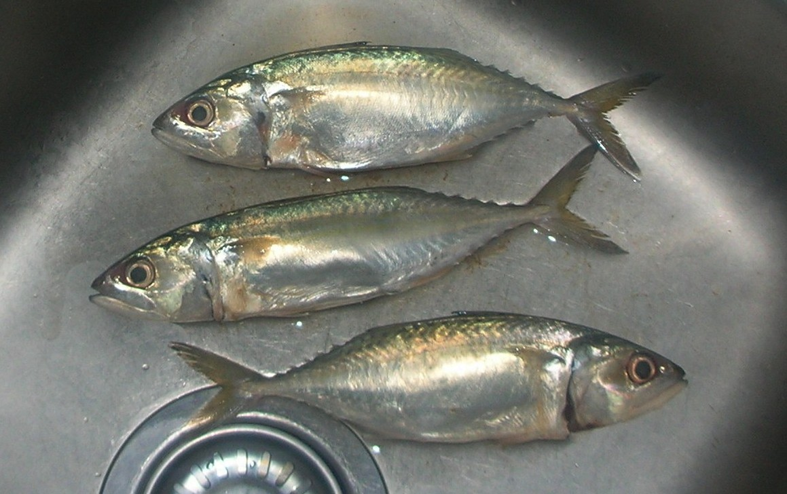
HOOK · 4 MIN
Where did the big fish go?
Pla thu (ปลาทู) — the fish in every market in Rayong.
Thailand lands pla thu by the hundred thousand tonnes.
Nobody anywhere lands hundreds of thousands of tonnes of the fish that eat pla thu.
Why not?
A
The big ones are just harder to catch.
Fresh pla thu, Rastrelliger brachysoma. Photo: Xufanc, CC BY-SA 3.0
B
There genuinely are not as many of them.
C
Nobody wants to eat them.
Vote. Write your letter in the margin. We come back to this at the end.
Notes:
HOOK — 4 minutes. Three clicks: the two statements together, then the question, then the three options staggered.
SAY: "Pla thu is the cheapest, most ordinary fish in Thailand. Your grandmother can buy it in any market. Now think of the fish that eat pla thu — pla kapong, groupers, the big ones. Have you ever seen a market stacked a metre high with those?"
Take the vote by hands and record it. Most classes split between A and B.
ANSWER (do not give it now, it is slide 15): B — and the reason is energy. Roughly nine tenths of the energy is lost at every step, so the further up the chain an animal feeds, the less of the sea is available to build it.
A is not stupid, and say so: big predators ARE harder to catch. But that would change the price, not the tonnage in the sea.
STRETCH: "What would you have to measure to tell A and B apart?" — Good answers: catch per hour of fishing effort. That is exactly what the Department of Fisheries measures, and it turns up on slide 16.

Slide 6
I DO · 4 MIN
food chain · producer · consumer
A food chain is a map of where the energy goes
Sunlight
Prong mangrove
ปูแสม sesarmid crab
ปูดำ mud crab
Little egret
energy arrives
PRODUCER
eats fallen leaves
eats the sesarmid crabs
eats the crabs
The arrow does not mean "eats".
It means the energy travels this way.
So the head of the arrow always lands on the eater — the one that just gained the energy.
Notes:
I DO — 4 minutes. Seven clicks: five build the chain a link at a time, then the rule, then the note.
EXACT WORDING, because this sentence is the lesson: "The arrow is not a picture of a mouth. It is a picture of energy moving. Read every arrow as the words GIVES ENERGY TO."
Then read the chain aloud that way: "The mangrove gives energy to the sesarmid crab, which gives energy to the mud crab, which gives energy to the egret."
WHY THESE TWO CRABS: ปูแสม (sesarmid) really does live on fallen mangrove leaves — it is the main route by which leaf litter enters the food chain. ปูดำ (Scylla serrata) is the largest invertebrate predator in the mangrove and eats other crabs and shellfish. Both are in the Prasae mud. If a student says "but my uncle catches ปูดำ", excellent — humans are the next arrow, and we are not on the slide.
MISCONCEPTION: someone will say the chain starts at the Sun so the Sun is a producer. The Sun is not alive. It is the energy source; the producer is the first LIVING link.
STRETCH: "Why is sunlight in a different colour box?" — because it is not an organism.

Slide 7
I DO · 3 MIN
One rule, two ways of getting it wrong
RIGHT
Energy moves from the crab that was eaten into the crab that ate it. Arrow follows the energy.
ปูแสม sesarmid crab
ปูดำ mud crab
WRONG
This says the mud crab gives energy to the sesarmid crab. It does not. It ate it.
ปูแสม sesarmid crab
ปูดำ mud crab
Read every arrow out loud as "gives energy to". If the sentence is nonsense, the arrow is backwards.
Notes:
I DO — 3 minutes. Four clicks: the RIGHT row, then the WRONG row — ask them what is wrong with it BEFORE you click again — then its explanation, then the banner.
Now go back to the Do Now tally on the board. Whichever way the room voted on Q5, settle it here, and settle it kindly — this is the single most common error in the whole topic and getting it wrong is not a sign of anything.
DO THE OUT-LOUD TEST with them, twice, so they hear how silly the wrong one sounds: "The mud crab gives energy to the sesarmid crab." Pause. "No it does not. It ate it."
They copy the banner sentence into their books. It is the one thing from today they should be able to recite in June.
STRETCH: "Is there ever a case where energy goes both ways between two organisms?" — Not in a food chain. But a decomposer takes energy from every level, which is why we draw it off to the side. That is slide 12.

Slide 8
WE DO · 6 MIN
food chain
Your turn: which way round?
Thumbs up if the arrow is right, thumbs down if it is backwards. Everyone votes before I click.
Phytoplankton
Copepod
RIGHT
The copepod eats the phytoplankton, so energy flows into the copepod.
Pla thu
Copepod
BACKWARDS
Pla thu eats copepods. The arrow should point at the pla thu.
Fallen leaf
ปูแสม sesarmid crab
RIGHT
Leaf litter is where most mangrove energy actually enters the animals.
Little egret
Mudskipper
BACKWARDS
The egret eats the mudskipper, so the energy ends up in the egret.
Every arrow on this slide is drawn pointing right. That is the trap — read the words, not the picture.
Notes:
WE DO — 6 minutes. Eight clicks: one reveals a pair, they vote, the next reveals the verdict and the reason. Four rows.
THE TRAP IS DELIBERATE and the footer says so: all four arrows point right, so they cannot pattern-match on the picture. They have to read the two names and apply the rule.
MODEL ANSWER for row 2, out loud: "Pla thu gives energy to the copepod." Nonsense. So it is backwards.
MISCONCEPTION TO WATCH: some students will call row 4 right because the egret is bigger and "more important". Size and importance are not what the arrow records. Say it plainly.
IF THEY ARE FLYING: skip the reason on rows 3 and 4 and ask a student to give it instead.
STRETCH: "Row 1 and row 2 are part of the same chain. Write that chain out properly." — phytoplankton → copepod → pla thu. Hold onto it; it is half of slide 15.

Slide 9
I DO · 4 MIN
herbivore · carnivore · omnivore · scavenger · grazer
Not all consumers make a living the same way
HERBIVORE
CARNIVORE
OMNIVORE
SCAVENGER
GRAZER
eats only plants
eats only animals
eats both
eats things already dead
feeds without killing
ปูแสม sesarmid crab, eating fallen mangrove leaves.
Little egret, taking mudskippers off the mud.
Long-tailed macaque — crabs, shellfish and fruit.
ปูดำ mud crab clearing a dead fish.
Periwinkle snails rasping algae off the roots.
Predator and prey are different words again
So a mudskipper is a carnivore. It is a predator when it takes a small crab, and it is prey when the egret takes it. Same animal, same afternoon.
Herbivore, carnivore and omnivore describe the MENU. Predator and prey describe the ENCOUNTER — who hunted whom, this time.
Notes:
I DO — 4 minutes. Five consumer cards, one click each, then the predator/prey panel in two clicks.
Teach the three -vore words as a SET, because the Latin roots do the work: herb = plant, carn = flesh, omni = everything. Thirty seconds on the roots saves a term of confusion.
The scavenger/decomposer distinction is the one that costs marks: a scavenger eats dead things WHOLE and is a consumer; a decomposer breaks them down CHEMICALLY. ปูดำ scavenging a dead fish is still a consumer.
MISCONCEPTION: "predator = carnivore". The mudskipper example kills it. Say the last sentence slowly: same animal, same afternoon.
MODEL ANSWER if asked about humans: omnivores, and predators of almost everything in this estuary.
STRETCH: "Is a grazer a herbivore?" — usually yes, but grazer is about HOW it feeds (not killing what it eats), not about what. A mosquito grazes on you.

Slide 10
WE DO · 3 MIN
herbivore · carnivore · omnivore · scavenger
Check: what kind of consumer?
Whiteboards. Write H, C, O or S. Hold them up together on three.
A sesarmid crab eating a fallen mangrove leaf
H
Only plant material — the leaf is still plant.
A little egret taking a mudskipper
C
Only animals. Also a predator, in this encounter.
A macaque eating crabs and figs
O
Both. Omni means all.
A mud crab eating a fish that washed up dead
S
It did not kill it. Scavenger — and still a consumer.
A mudskipper caught by an egret
C
Careful — the mudskipper is a carnivore AND prey. Both are true.
Notes:
WE DO — 3 minutes. Ten clicks: letter then reason, row by row. Always take the boards up BEFORE you click.
Row 5 is the one worth the time. Both answers are right: carnivore describes its diet, prey describes what just happened to it. If a student argues, they have understood — say so out loud.
Row 4: expect a scattering of D for decomposer. That is the scavenger/decomposer line again. Ask: "Did the crab break the fish down into chemicals in the mud, or did it eat it?"
Row 1: expect some C, because a crab looks like a meat-eater. The menu decides, not the animal's reputation.
IF MOST OF THE ROOM IS SECURE by row 3, stop the slide and move on. This is a check, not an activity.

Slide 11
I DO · 5 MIN
food web
Two chains, one estuary — and they share
The water chain
Phytoplankton
Copepod
Pla thu
Pla kapong
A food web is not a bigger chain.
It is the alternative routes — and alternatives are what keep an estuary standing when one species has a bad year.
Mudskipper
Prong mangrove
ปูแสม crab
ปูดำ crab
Little egret
The mud chain
Decomposers feed on every single box on this slide.
Notes:
I DO — 5 minutes. Build it: mud chain (4 clicks), water chain (4 clicks), then the three shared links, then the note, then the decomposer banner.
SAY while the shared links appear: "Watch the egret. It was at the end of the mud chain. Now the mudskipper reaches it from the water chain too. Two different routes, same bird."
THE POINT, and make it explicitly: a web is not drawn to look complicated. It is drawn because alternatives exist, and alternatives are what stop an ecosystem falling over when one species has a bad year.
MODEL ANSWER for "trace two routes to the egret": phytoplankton → copepod → mudskipper → egret, and mangrove → ปูแสม → ปูดำ → egret.
MISCONCEPTION: "the arrows crossing means the animals meet". No — crossing lines are an accident of drawing.
DECOMPOSER BANNER: deliberately a banner and not a box in the web, because if you draw it in the web students put it at the end. It feeds off every level. That is all they need today; where the nutrients GO is Lesson 3.
STRETCH: "Which single box would do the most damage if it disappeared?" — phytoplankton, because it feeds the whole upper half and nothing replaces it. Hold that thought for the worksheet Gold.

Slide 12
YOU DO · 11 MIN
On your own — worksheet, Section A to C
Start where you like. Move up when a question stops being hard.
BRONZE
SILVER
GOLD
Fluency
Mixed practice
Reasoning
Arrows, names and groups. Get the direction automatic.
Build chains and read the web. Apply it to new animals.
Predict, justify and explain the energy. Full sentences.
Stuck, or finished early? Use Gemini properly.
The three prompts are on the last page of your worksheet — copy and paste them. One quizzes you on the arrow rule, one checks your food-web reasoning, one marks your Gold answer against the criteria. None of them will write an answer for you, and I can tell. Check everything it says against your own notes.
RAG grid, front page — fill in the "end of lesson" column before you pack away.
Notes:
YOU DO — 11 minutes. Everything is already on screen; no clicks needed.
CIRCULATE WITH ONE QUESTION: "Read me that arrow as gives energy to." It diagnoses almost everything in thirty seconds.
WHERE THEY WILL STALL: B4 (drawing the web from a description) — tell them to draw every box first and put the arrows in last. C5 (Gold, removing the phytoplankton) — tell them to follow the arrows upward and name three named organisms, not "everything dies".
The Gemini prompts are on the worksheet, not on the board, so the board stays free for the web from slide 11 — leave it up if you can, they will want it.
AT 3 MINUTES REMAINING: stop them wherever they are and move to the reveal. The reveal is worth more than three extra minutes of writing.

Slide 13
REVEAL · 3 MIN
energy · trophic level
So — where did the big fish go?
The answer was option B. There really are fewer of them, and here is why.
Pla kapong
1
About nine tenths of the energy is lost at every step.
a fraction of a unit · level 3.8
Most of it is spent just staying alive, and leaves as heat. Only what gets built into a body is left for the next mouth.
Pla thu
2
So each level up has roughly a tenth as much to build with.
about 1 unit · trophic level 2.7
A tenth of the ENERGY — not a tenth as many animals. Bigger animals need more each, so the numbers fall faster still.
Copepods
3
Pla thu feeds at level 2.7. Pla kapong feeds at 3.8.
about 10 units
A whole extra step up the chain, so it takes roughly ten times more sea to make the same weight of pla kapong.
Phytoplankton
4
That is why the chain stops at four or five links.
100 units of energy
There is not enough energy left to feed anything that would make a living out of eating pla kapong.
Trophic levels from FishBase, based on stomach-content studies. Energy figures are the standard rough tenth — real ecosystems vary.
Notes:
REVEAL — 3 minutes. Build the pyramid bottom-up (4 clicks), then the four points (8 clicks).
Go back to the vote you recorded on the hook. Announce B.
EXACT WORDING for the key idea: "Energy is not shared out. It is spent. Every animal spends most of what it eats just on being alive — moving, breathing, staying warm. Only the leftover gets built into a body, and only a body can be eaten."
HONESTY, and say this out loud: the tenth is a rule of thumb, not a law. Real transfers run from about 2% to about 20%. And pla kapong is scarcer than pla thu for other reasons too — it is farmed, it is fished hard, it grows slowly. Energy is the biggest reason, not the only one. Students who spot that deserve credit.
MISCONCEPTION: "so energy gets recycled at the bottom". No. Energy flows through once and leaves as heat. The NUTRIENTS get recycled — and that is Lesson 3. Promise it, do not teach it.
STRETCH: "Pla thu is at 2.7, not 3. What does a decimal trophic level even mean?" — it eats a mixture: mostly plant plankton, some animal plankton. It is 70% of the way to being a pure herbivore. Genuinely good question if it comes up.
STOP HERE if you are short. Slide 16 is context, not curriculum.

Slide 14
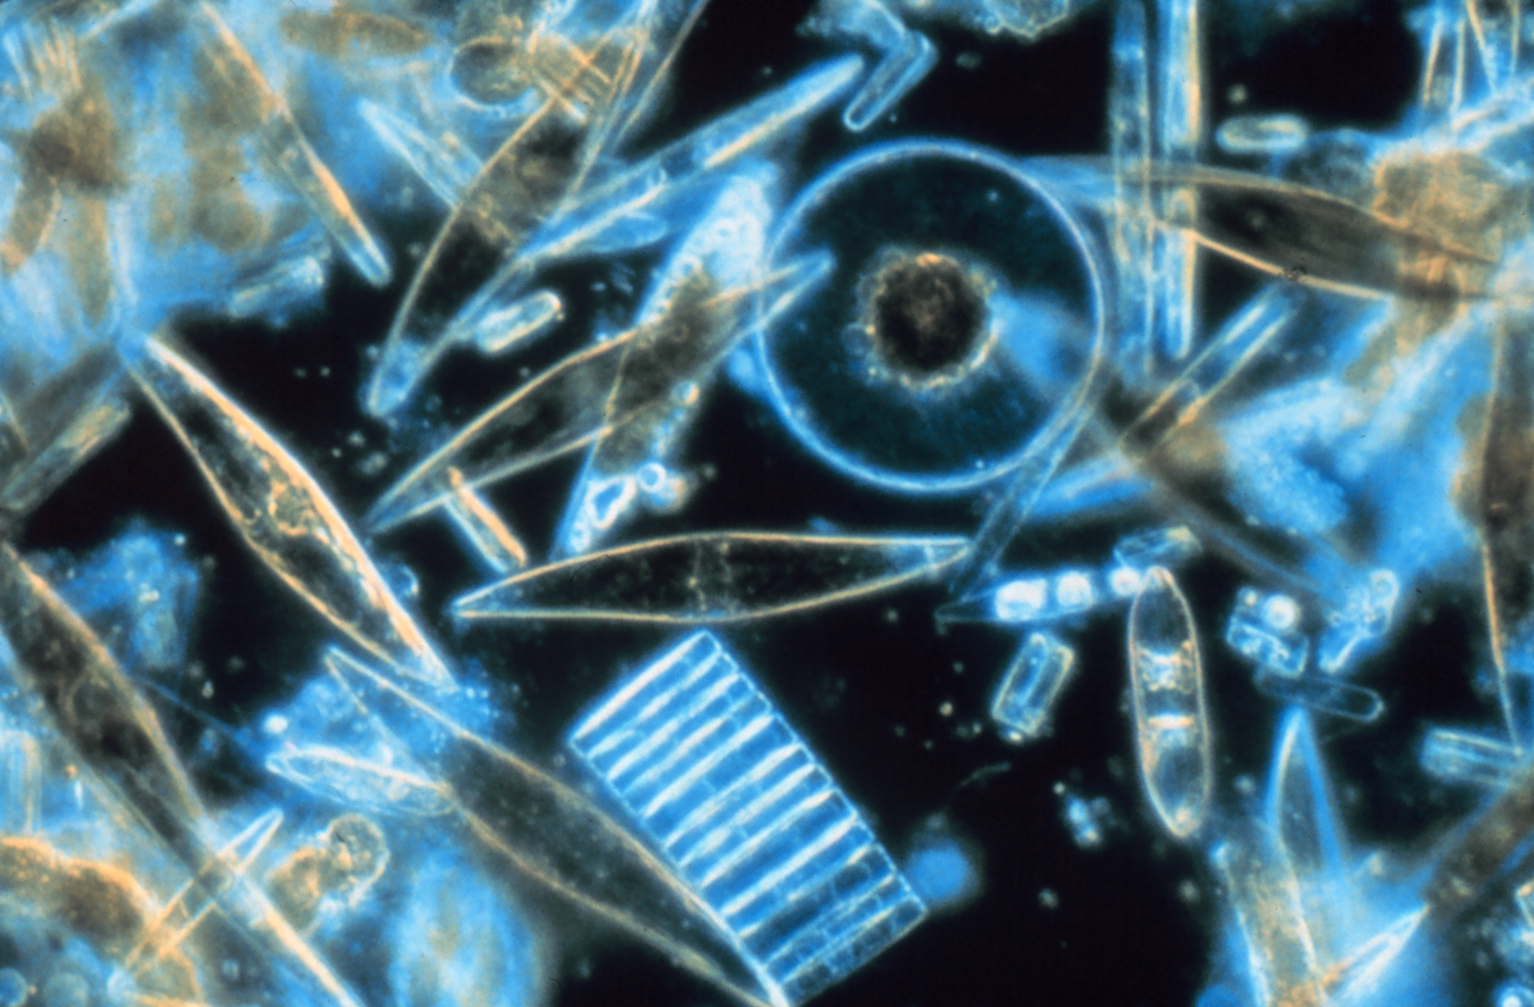
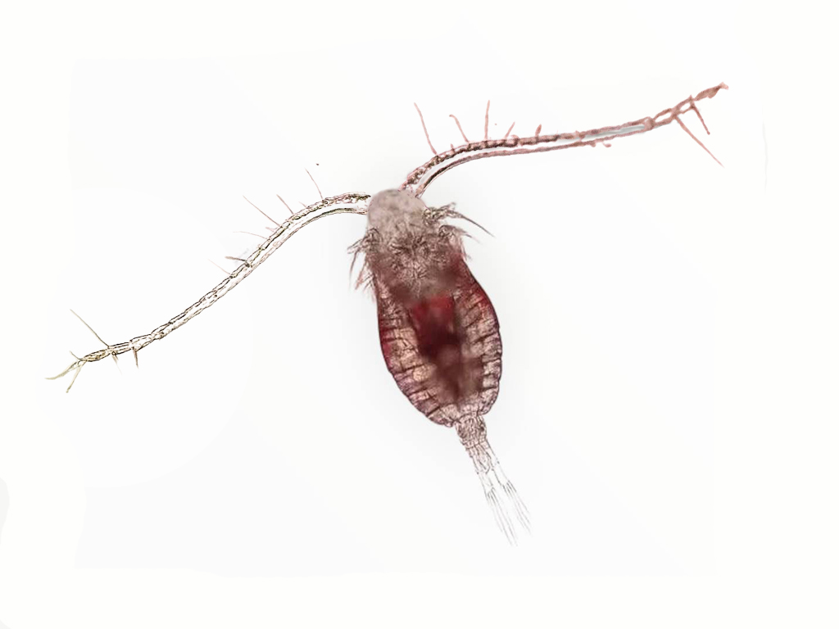
CONTEXT · 1 MIN
What a pla thu actually eats
One stomach, counted
Researchers opened 541 pla thu from Pattani Bay and counted what was inside.
Diatoms — 47%
Copepods — 16%
Dinoflagellates — 14%
So nearly half of a pla thu is producer, eaten directly. That is why it sits at 2.7 and not at 3.
A live copepod photographed in Thailand — a consumer, about a millimetre long. Photo: Lion Pods, CC BY 4.0.
Diatoms — single-celled algae, and producers. These particular ones came from Antarctic sea ice; the group is the same one that feeds the Gulf. Photo: Prof. Gordon T. Taylor, Stony Brook University, public domain.
Notes:
CONTEXT — 1 minute, and it is optional. Cut it first if you are behind.
Three clicks: the two photos, then the panel.
WHY IT EARNS ITS PLACE: it shows them that trophic level is a measured number, not a label someone assigned. Somebody opened 541 fish and counted.
NOTE THE HONEST CAPTION on the diatom photo — those cells are from Antarctic sea ice, not the Gulf. If a sharp student notices the mismatch before you say it, that is a win; tell them so.
MODEL ANSWER for "why does it matter that it eats producers directly?" — it skips a step, so it wastes less energy, so there can be far more of them.
The copepod photo was taken in Thailand. A millimetre long. Hold your fingers up.

Slide 15
CONTEXT · 2 MIN
Fishing down the food web
The Gulf of Thailand, measured by the same survey boats since 1961.
EARLY 1960s
BY THE 1990s
WHAT CHANGED
EVERY FEB–MAY
A survey trawl brought up about 300 kg of fish for every hour it towed.
The same survey, the same boats: 20 to 30 kg an hour. By 1995 the trawlable biomass was about 8% of the 1961 level.
The big, slow, high-level fish went first. More than 40% of the catch is now low-value or juvenile fish — smaller animals from further down the web.
For decades the central Gulf has been closed to trawlers from 15 February to 15 May, across the pla thu spawning season. In 2020 the Department of Fisheries reported yields of key species up 1.6 times year on year.
Energy flow explains the pattern: take out the top of the web and the fishing moves down it. Each step down is a step towards the producers — where the energy still is.
Sources: Thai Dept. of Fisheries trawl surveys via Frontiers in Marine Science 2017; WorldFish 1961–95 biomass study; Bangkok Post, 12 June 2020.
Notes:
CONTEXT — 2 minutes. Four clicks, then the closing point.
SENSITIVE — read the teacher slide before you teach this. Rayong is a fishing province. Some students will have family in fishing, in shrimp farming or in seafood processing. Frame it as a system being asked for more energy than it can make, never as a story about bad people.
THE SCIENCE POINT, and it is the only one that matters: as the high-level fish disappear, the fishing moves DOWN the web towards the producers. There is more energy down there, which is exactly why it still works. The ecologist Daniel Pauly named this "fishing down the food web" in 1998.
CARD 4 IS DELIBERATELY LAST. The closed season is not new — Thailand has been doing it since at least the early 2000s and the boundaries move as the surveys change. Do not leave them on the collapse. The closed season is a real policy, it has real numbers attached, and the Prasae mangrove they met last lesson is the same story: Chalome replanted the producers, and the crabs and fish came back. More producers, more energy, more consumers.
IF A STUDENT ASKS whether the closure is enough — honest answer: nobody is sure, and the department keeps changing the boundaries based on the surveys. That is what science in public looks like.
IF A STUDENT HAS READ ABOUT labour abuse in the Thai fishing fleet: it is real and it is documented, but it is not today's lesson. Acknowledge it and move on.

Slide 16
PLENARY · 2 MIN
True or false?
Stand up for TRUE. Stay sitting for FALSE. No fence-sitting.
1. The arrow in a food chain points from the eater to the food.
FALSE
It follows the energy, so it points AT the eater.
2. A scavenger is a kind of decomposer.
FALSE
A scavenger eats dead things whole. It is a consumer.
3. A carnivore can also be prey.
TRUE
The mudskipper hunts crabs and is hunted by egrets.
4. Decomposers belong at the end of a food chain.
FALSE
They feed on every level of the web.
5. Energy is recycled round and round an ecosystem.
FALSE
It flows through once and leaves as heat. Matter is what cycles — next lesson.
Next lesson: the energy is gone — so why does the estuary not run out of nitrogen?
Notes:
PLENARY — 2 minutes. Eleven clicks: each statement, then its verdict and reason together, row by row — then the closing line for Lesson 3. Always make them commit BEFORE the verdict.
Every false statement here is a misconception from the hidden teacher slide. If a row splits the room, write it on your seating plan — that is your Do Now for next lesson.
Q1 is the retake of the Do Now question. Point at the tally still on the board.
Q5 IS THE HOOK FOR LESSON 3, so do not resolve it beyond the sentence on screen. Leave them with the closing line: the energy is gone for good, but the nitrogen in that leaf has been round the estuary thousands of times.
THE MOTIF RETURNS top right — same sun, same tree, one arrow. Nobody will mention it. It still works.
STOP HERE. Objective 5 is Lesson 3.

Slide 17
Credits and sources
IMAGES — all Creative Commons or public domain
Fresh pla thu, Rastrelliger brachysoma
Xufanc · CC BY-SA 3.0 · Wikimedia Commons
Diatoms through the microscope
Prof. Gordon T. Taylor, Stony Brook University · public domain
Live copepods, photographed in Thailand
Lion Pods · CC BY 4.0 · Wikimedia Commons
SOURCES
Trophic levels: pla thu 2.7, pla kapong 3.8
FishBase, species summaries, based on stomach-content studies
Pla thu stomach contents, 541 fish, Pattani Bay
Feeding habits of Rastrelliger brachysoma in a tropical estuary, 2022
Gulf trawl survey CPUE, 1961 to the 1990s
Thai Dept. of Fisheries surveys, via Frontiers in Marine Science, 2017
Trawlable biomass 1961–95
Status of demersal fishery resources in the Gulf of Thailand, WorldFish
Seasonal closure and 2020 yields
Bangkok Post, 12 June 2020, quoting Bancha Sukkaew, Dept. of Fisheries
Mangrove crab feeding ecology
Sesarmid leaf consumption and Scylla serrata predation, peer-reviewed literature
Objectives and vocabulary
CK-12 Lesson 19.2 · GIS KS3 SoW, Y9 Term 1.1 Unit 2
Notes:
Not shown in the lesson unless someone asks. Kept in the file so the licences and the numbers travel with the deck if you share it.

